Slide 1
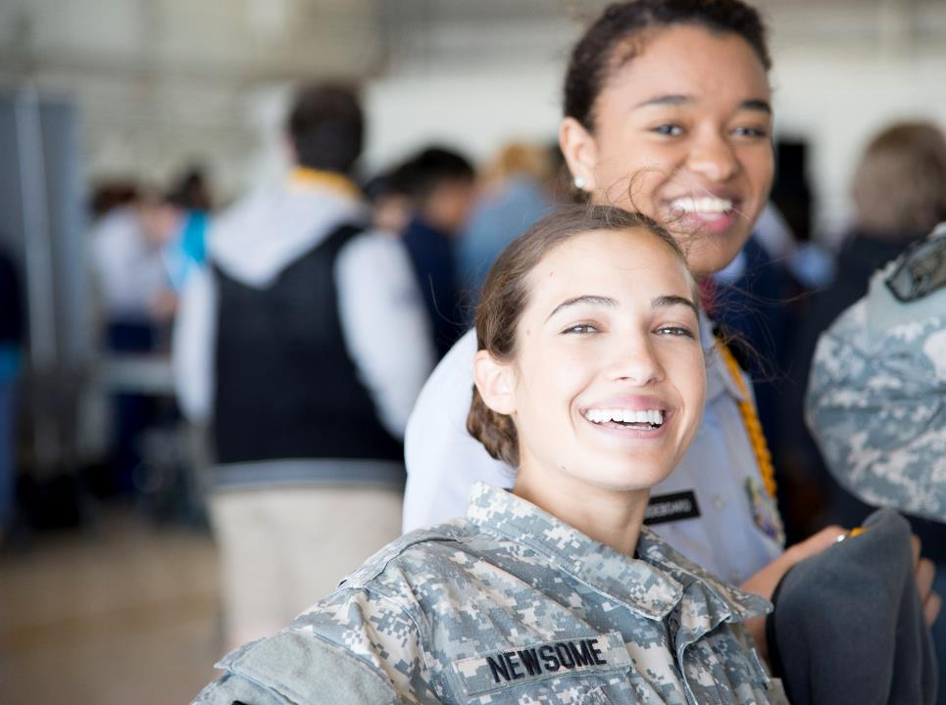
MacDill STEAM
Science, Technology, Engineering
Arts & Mathematics
Presented by
Terry Montrose
Commander
Col Stephen Snelson

Slide 2
STEAM
How we started
Necessity is the mother of invention

Slide 3
STEAM should you, can you?
SHOULD IT BE A PRIORITY
Can you make it a priority?
Results wont be seen for years
You commander has different priorities
You are already either undermanned or under experienced
You have to make it easy and/or convenient
Steam Event
Combine all school events
Flying Classroom – leave it to OG

Slide 4
STEAM the obvious is not so obvious
Making STEAM fulfill a need
AFI 35-105
1.2. Objectives of Community Engagement.
1.2.1. Increase public awareness and understanding of the armed forces and the mission, policies, and programs of the Air Force.
1.2.2. Support Air Force recruiting by inspiring patriotism and encouraging men and women to serve in the military.
1.2.3. Maintain a reputation as a good neighbor as well as a respected and professional organization charged with the responsibility of national security.
1.2.4. Preserve new and enduring overseas relationships with allies, coalition, and multi-national partners.
How many JROTC/CAP/ROTC/high school tour request do you receive a year? (See 1.2.2)
Do you have a school on base?
Do you have a school council on base
AFRC mock deployment line
At-risk youth groups/Make A Wish, etc.
Insert your youth group here
Combine all of those request into a single STEAM event
Save valuable mission time
Event is now big enough for media…more impact
Your base will thank you/great bullets

Slide 5
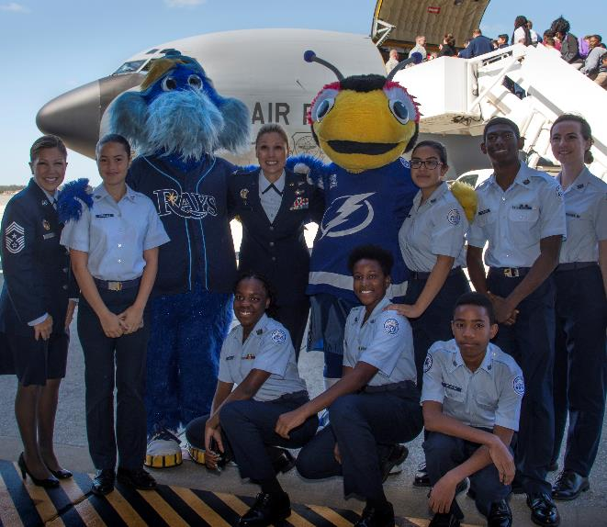
MacDill STEAM
Largest STEAM event in the Air Force and Florida
1300 Students, 6 -12 grade
29 different schools
Ohio and Georgia
42 exhibitors
72 Volunteers
9 Different Committees
Designed to expose students to skills needed to keep America "the world’s engine of scientific discovery

Slide 6
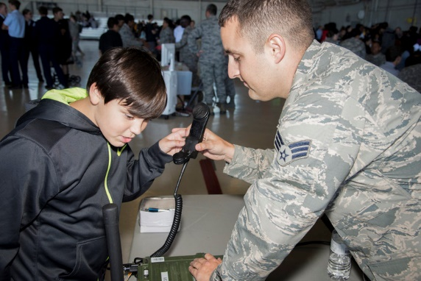
Steam Contributors
Community
Busch Gardens
Tampa Bay Rays
Tampa Bay Lightning
USF (Space Program)
Military
USSOCOM
JCSE
SOFWorx
Local Schools
Lennard
Robinson
Meteorology
Para Commandos
FAB Flight
Monroe
+7

Slide 7
Steam MAP
JCSE Deuce
HMMMVVEE
KC135
U.S. marines
Porta potties
Ambulance
Crash Fire
JCSE
Marine Patrol
**No drone flights outside of hangar
Comm
Transmission
Science
DV Lounge
EOD
BIO
Ver Sol
Rigger
MIddleton
Robotics
Go Kart
Trebuchet
Balsa Bridge
Restroom
Drones
Parachutes
Robots
Lennard
Information
Library
Library
IPE
Public Affairs
STEM Kits
Maritime
Jefferson
Drone
Mopp 4
Jeff ROTC
Turner Bartel
Engineering
Dental
lunch Serving area
Kids will bring their own lunch
Bush Garden
Omnicam
Architecture
Animal Science
Screech Owl
TBT
TBT
Stewart
Stewart
Medical
veterinarian
Entrance
Entrance
Vet Science
Modeling/
Simulation
Monroe
Robinson
Randall
Randall
Microscope
Vein Finder
SOCOM Acq
Fab Flight
Meteorology
Lightning
Science of Ice
USF
SOFWERX
SOFWERX
Fab Flight

Slide 8
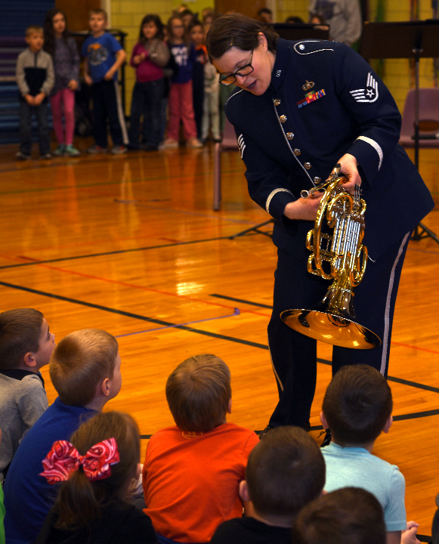
Why the “A”
Everyone knows the popular STEM acronym
Having Air Force professional musicians visit schools allows the Air Force to use the "A" in STEAM as access to provide an introduction and storytelling element to highlight other Air Force mission areas
The arts are a great learning tool and can serve as an on-ramp to STEM for underrepresented students or enhance existing education.
Engaging students’ strengths using art activities increases motivation, access to schools, and the probability of STEM success

Slide 9
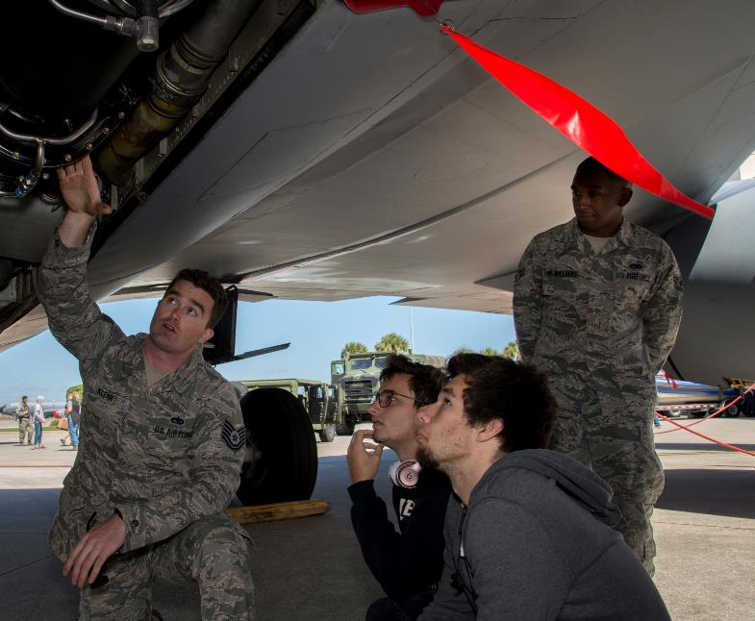
Why the effort
Education is vital to recruiting and retaining America's future force
Interaction with Airmen in schools will help students and educators gain insight into Air Force opportunities, which will help recruit new Airmen
You cannot mass produced highly skilled professionals at once
** See AFI 35-105 1.2.2
“STEM skills are foundational to success as an Air Force and nation. We want to partner with schools to help students know that if they work hard, there is a place for them on our team. Our talented and innovative musicians
create memorable learning opportunities for
students, aiding local education efforts and
paving the way for future interaction"
Gen Carlton D. Everhart II,
Air Mobility Command Commander

Slide 10
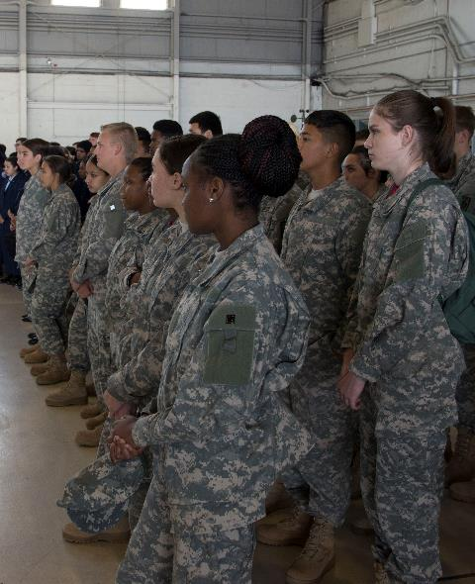
the Challenge
Being the world’s greatest Air Force is not a birthright; we have technical workforce challenges to overcome
- Declining “homegrown” talent from the U.S.
- Worldwide competition for STEM talent
- Aging STEM workforce
U.S. 15-year olds rank 17th in reading, 30th in math, and 23rd in science worldwide
U.S. is 27th in percent of first degrees in STEM vs. all degrees
40% of Air Force STEM civilians are over 50 years old
The Air Force has over 25K STEM-degreed Airmen working in STEM jobs
Never before in our history have we depended more heavily on the application of technology – to fly, fight and win…in air, space, and cyberspace

Slide 11
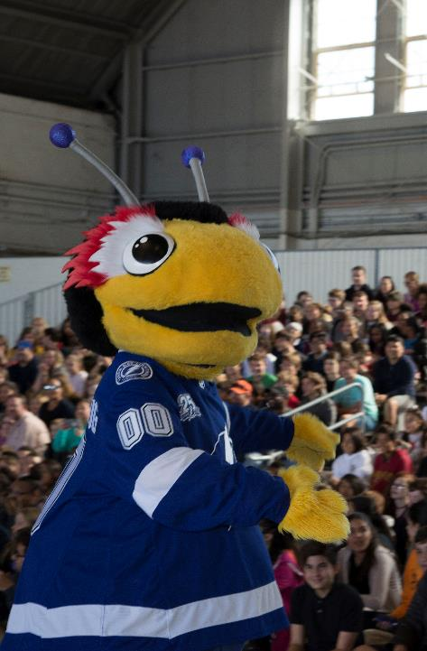
How
Initiatives focus on not only recruiting but also addressing education needs in our communities
School Liaison Officer
MacDill Education Advisory Council
STEAM Day, JROTC Day, ROTC Incentive Flights
**Flying Classrooms
Partnering with civic leaders and educators to inform future initiatives.
Actively bolstering its partnership Hillsborough County and other school districts while developing leadership initiatives in the areas of Science, Technology, Engineering, Arts and Math (STEAM).

Slide 12
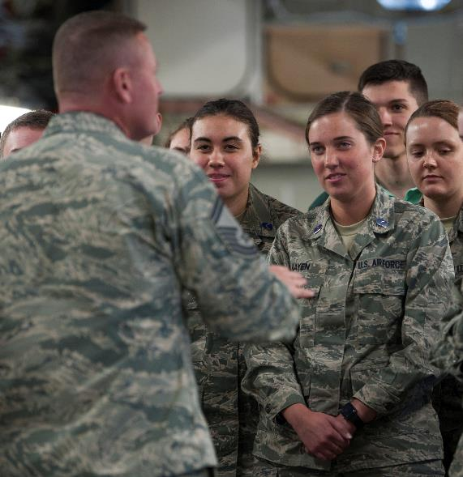
Flying Classrooms
Allows us to leverage local training missions, transforming them into flying classrooms for students to address the increasing need for science, technology, engineering and mathematics professionals in the Air Force.
Flying classrooms serve as an interactive entry point to the Air Force, ultimately inspiring future generations of aviators
Continue to partner with civic leaders to help bolster participation and leadership involvement in STEAM.
SMSgt Kirk Hayes addresses University of Miami
students aboard a C-17 during a 3 hour flight to MacDill’s Steam Day

Slide 13
Flying Classrooms
Remember This??
Flying Classrooms are even less of a priority
NO PROBLEM!
Push the EASY BUTTON
Results wont be seen for years
You commander has different priorities
You are already either undermanned or under experienced
Who is responsible for JROTC/CAP/ROTC travel?
Hint: Not PA
Work OG/ local school
Simply find a guest speaker
Involve aircrew…work w/OG
Remember the goal is to “inspire”

Slide 14
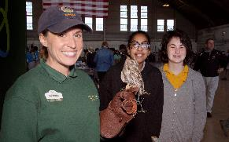
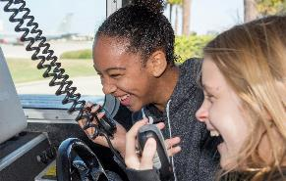
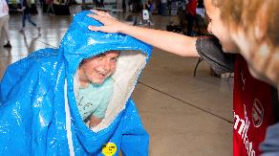
Helpful HINTS
Logistics
Exhibits should be targeted between an 10th & 11th grade
Exhibits should have activities that can be adapted to several ages
Be careful in the use of too many technical words
Develop a “Take Home” message
Give them something to touch
Don’t forget passersby who may be interested
Keep your presentation active by asking questions
High and low tech activities
People learn best by listening, seeing & experiencing

Slide 15
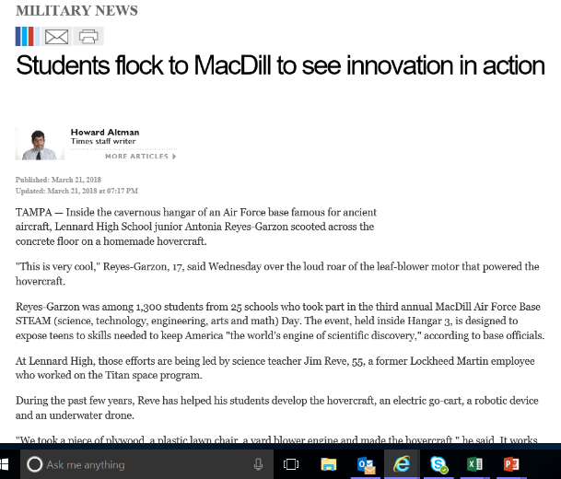
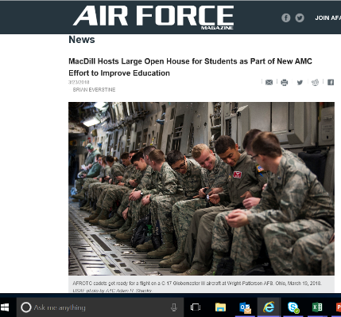
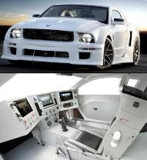
Resources
Money
Vicki Stoneking, AF STEM
Loren Proud, DoD STEM
Flexible Money - Plattsburg
Wright Patterson AF Research Lab
http://www.wpafb.af.mil/afrl/
AF SuperCar
Social Media
Snap Chat Filters, etc.
Youtube Channel
Think outside the box
Take advantage of your base
AF Super Car

Slide 16
Keep Inspiring

